Slide 1


Memory according to WACE & ATAR
Year 12
Psychology

Slide 2
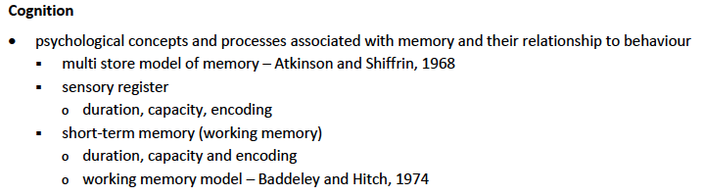

Slide 3
Working Memory Office Analogy
The PL & VSS are storage components – they hold auditory verbal and visual/spatial info. But they are not merely there for storage. The PL maintains auditory verbal information in working memory by encoding, temporarily storing and repeating (in a loop) the info. The VSS helps us to mentally visualise and manipulate visual and spatial information e.g. how our room might look if we moved our study desk near the window.
The CE is like an executive director or boss. It is the decision maker and controller. It controls what info comes in from the PL & VSS, thus deciding what sensory info is important and what is irrelevant. It also commands the episodic buffer to get info from the LTM if needed.
The working memory is still connected to LTM. The LTM is like a filing system with so much info stored inside. Sometimes we solve problems or try to make decisions on an issue and need previously stored info that’s already in our LTM. E.g. we require old formulas to solve a maths problem. Of course, our CE can command our EB to get such info from the LTM if we require it.
The EB is like a secretary under the control of the CE. It allows working memory to interact (and get info from) LTM if that info is required to solve a problem or make a decision. It is also known as a ‘mental workbench’ as it provides a temporary working space in which we can solve problems
.

Slide 4
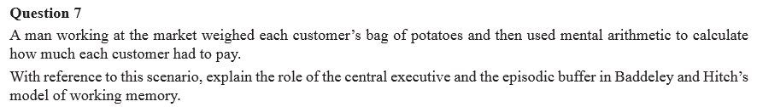
VCAA 2011, SA. Q.7
As the man weighs each customer’s bag of potatoes, his central executive (CE) would ‘command’ his episodic buffer to interact with and tap into his long-term memory (LTM) to retrieve information about how to add and multiply. The CE would then integrate visual information from the visuo-spatial sketchpad to mentally ‘visualise’ and calculate the sums in his head. Finally, as the CE is the ‘decision maker’, it would allow the man to calculate and decide the total amount each customer has to pay.
It’s one thing to know content – but you need to also be able to apply that content to a given scenario (it’s not as difficult as it sounds and comes through doing lots of practice Qs and thinking of examples for each topic)
Try to use the Office Analogy to help guide your answer (if it makes sense!).
You can use abbreviations but always mention the full form first!

Slide 5
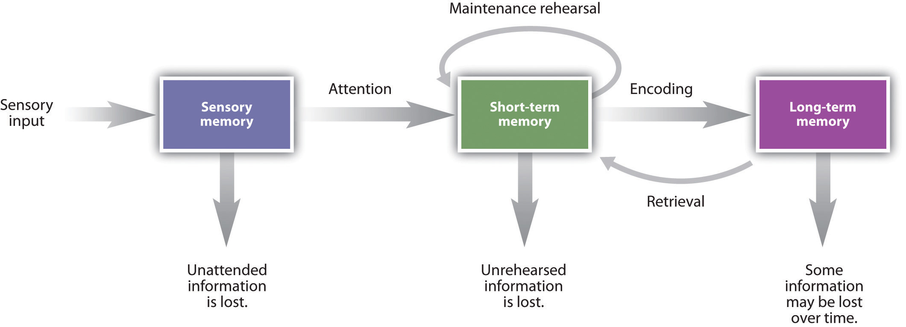
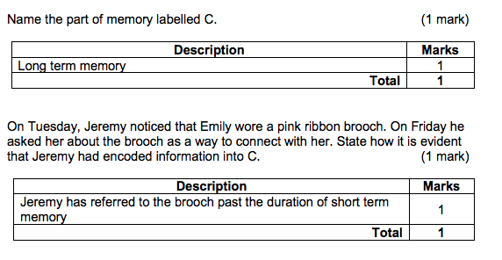
2017 WACE

Slide 6
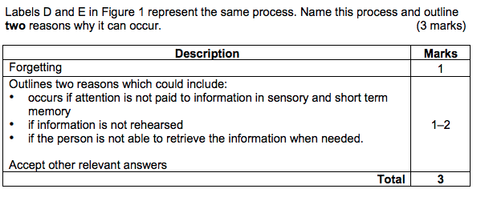
2017
ATAR

Slide 7
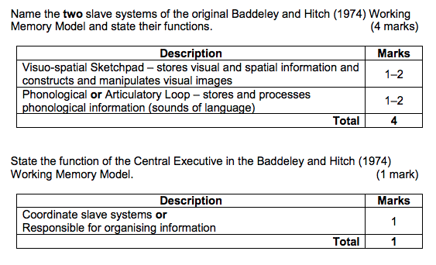
2017
ATAR

Slide 8
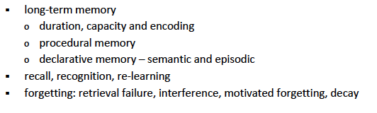

Slide 9
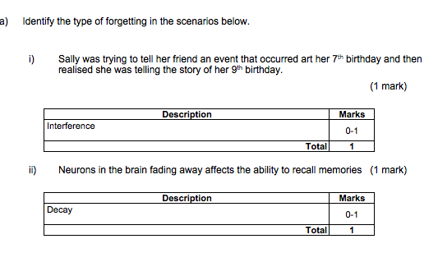
2016 Mid Sem

Slide 10
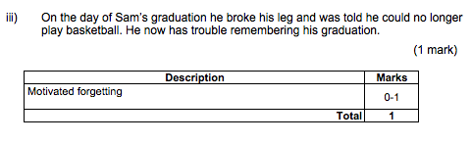
2016 ATAR SEM 1

Slide 11
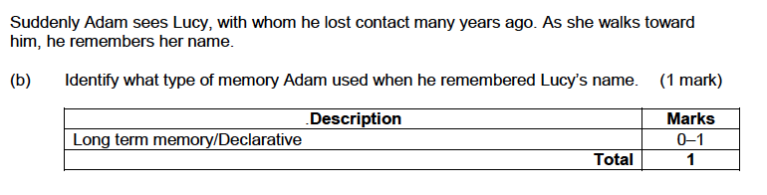
2014 WACE

Slide 12
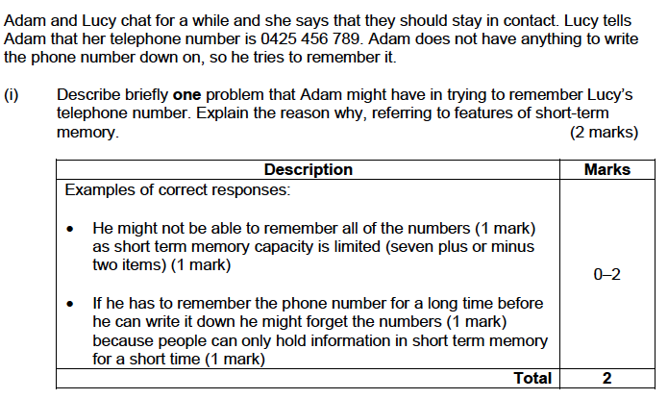
2014 WACE

Slide 13
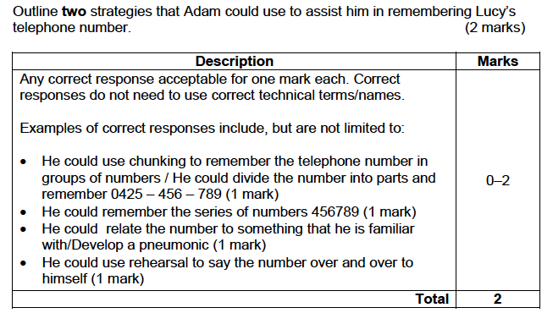
2014 WACE

